Slide 1
Slide evaluation
TASK
Look at the following three slides
What quality criteria are NOT met?
List them in the NOTES section under each the slide
Improve each slide to a quality slide
In the note section you can list and justify the changes you made
Notes:
Use your checklist as a guide to check for the criteria a quality slide should meet

Slide 2
ABRASIONS
Or grazes – road rash
These are superficial wounds that people can get, generally the outermost layer of the skin is rubbed away, but no more,
Common with children and sport players who tend to fall on the ground and then slide along the ground, eg: motor bikers.
Prone to infection, which can cause further problems

Slide 3
Calculating Percentages
Percent comes from Latin and means “for every 100” or “out of a hundred”
The symbol to express that a number represents a percentage is “%”
Percentages allow us to compare proportions between different sets of numbers. For example
Which school has got more successful year 7 Moths students?
School A: 15 out of out 100 students achieved grade A
School B: 11 out of out 70 students got grade A
School B’s 11 students sound less impressive than school A’s 15, but is it really lower as a proportion of all the students?
School A’s result are 15/1000 or 15%
School B’s results are 11/70 or 15.7%

Slide 4
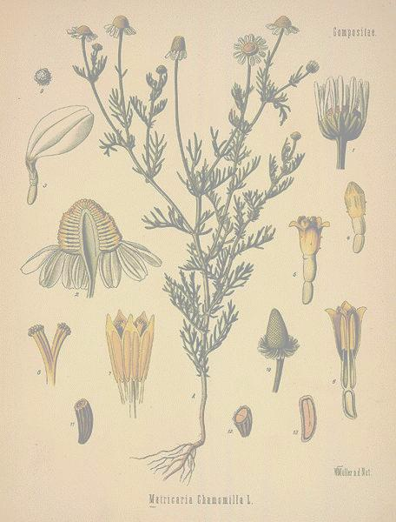
Regulation of Herbs and Drugs
Regulation varies from country to country
Herbs are classified as dietary supplements in United States
Manufacturers are limited in claims they can make
US Regulating Agencies
American Herbal Products Association
Natural Nutritional Foods Association
Safety with herbs
Be informed
Dosage
Side effects

