Slide 1
PowerPoint World
Interactive PowerPoint in facilitation
Notes:
Slide 1 demonstrates
Entering text
Title slide Layout, font Calibri (headings) size 43, colour theme executive
Font Calibri (body), size 26
Transition, on click, to next slide: push
Inserting of footer with slide number
This part demonstrates adding of notes

Slide 2
PowerPoint World
Interactive PowerPoint in facilitation
Notes:
Slide 2 demonstrates
Duplicated previous slide but changed theme (Trek) and format text of previous slide
Layout: Title slide
heading title in WordArt (fill, text effect: transform), font Ariel
Font body Old English text size 32
Bullet
Animation: swivel; automatic time 1.75 sec
Transition, on click, to next slide: push

Slide 3
PP in facilitation
Develop skills in use MSPP
Plan using PP in a session
Design slides
Use PP in session
Notes:
Slide demonstrates
Inserted new slide
Layout: Text and content
Hyperlink to “design”
Various animations: appear, fly in, bouncer, split + emphasis: wave; manual – on click

Slide 4
PP in facilitation
Develop skills in use MSPP
Plan using PP in a session
Design slides
Use PP in session
Notes:
Slide demonstrates
Text and content layout
SmartArt: segmented process / colourful range
Different text alignments: right / centre / left and again centre

Slide 5
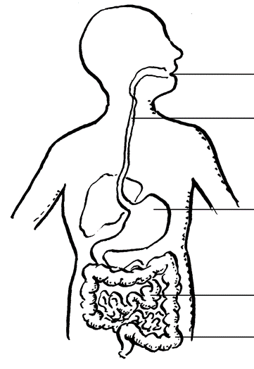
The digestive system
Notes:
Inserted blank slide
Inserted text box
Centred text
Font Tahoma size 32
Inserted picture of digested system
Inserted interactive text boxes (to be typed in during presentation as responses from learners)

Slide 6
1
2
3
Notes:
Slide demonstrates
Layout: Blank slide
Inserted picture
Copied picture
Resized picture 1 to size picture 3
Copied and cropped picture 1 to picture 2
Picture style picture 3 – metal frame
Inserted text boxes to number the picture 1, 2, 3
Aligned textbox 2 and 3
Transition to this slide random bars

Slide 7
Slide 1 demonstrates
Entering text
Title slide Layout, font Calibri (headings) size 43, colour theme executive
Font Calibri (body), size 26
Transition, on click, to next slide: push
Inserting of footer with slide number
Some special symbols and characters
Ѱ Ѳ ❶
Notes:
Inserted a blank slide
Bulleted list
Inserted text box
Heading bold / Calibri size 36
Text Calibri size 28
Various colours for the text: green, purple, red, black, blue
Inserted text box with some special characters

Slide 8
Formatting a picture
I
II
III
Notes:
Inserted new slide
Layout title only
Copied picture 2 from slide 6
Changed brightness and contrast in picture II after copying picture I
Inserted text boxes
Aligned textboxes
Coloured Roman numerals I , II and III
Changed colour in III from copy of picture of slide 6 to Indigo

Slide 9
SHAPES
My name is Sunny
Here I inserted hyperlink to a videoclip on How to embed a YouTube Video into PowerPoint
Notes:
New slide with tile only
Inserted shapes – basic shape and call out
Resized shapes
Filled face with colour
inserted textbox in the call out

Slide 10
Work in progress
Here to place a table
Here to place chart to represent date in the table

