Slide 1
Week 2: Using online resources responsibly
C-DELTA Training of Trainers online course

Slide 2
Learning Outcomes
understand permissible use of online resources and use them responsibly
understand the benefits and challenges of using open education resources
Notes:
This week we are exploring strategies to help you improve your skills and strategies in searching for and finding online information. You also need to when you are allowed to use online resources and the benefits of open education resources.

Slide 3
Paywalls, Copyright and OERs
https://commons.wikimedia.org/wiki/File:Paywall_Logo_RBG_JPG_2.jpg
https://commons.wikimedia.org/wiki/File:Global_Open_Educational_Resources_Logo.svg
https://picpedia.org/handwriting/c/copyright.html
Notes:
We are now going to cover some fundamental concpets about online resurces and how you can use them responsibly
You have probably already heard these expressions and concpet before.

Slide 4
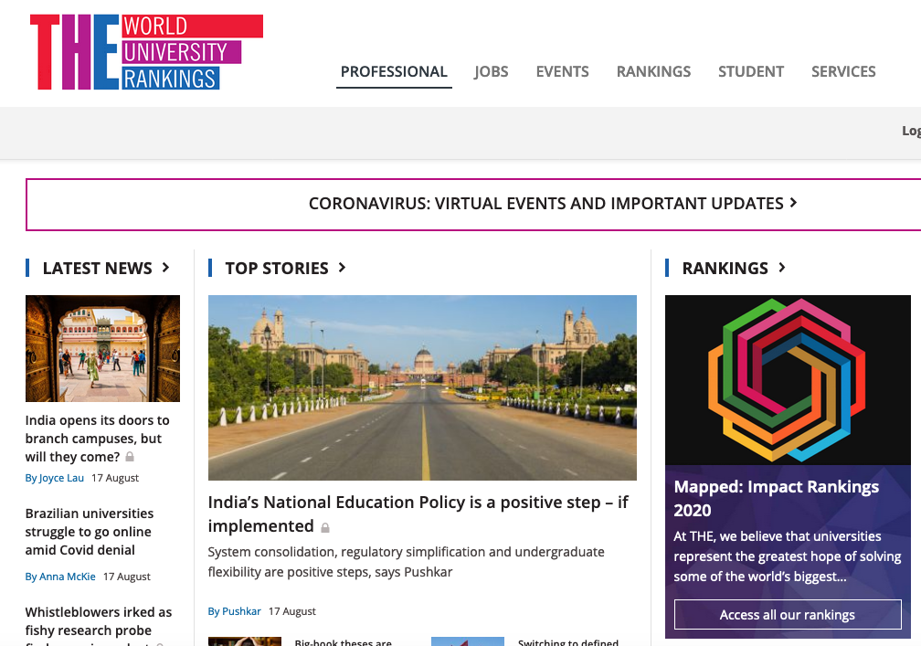
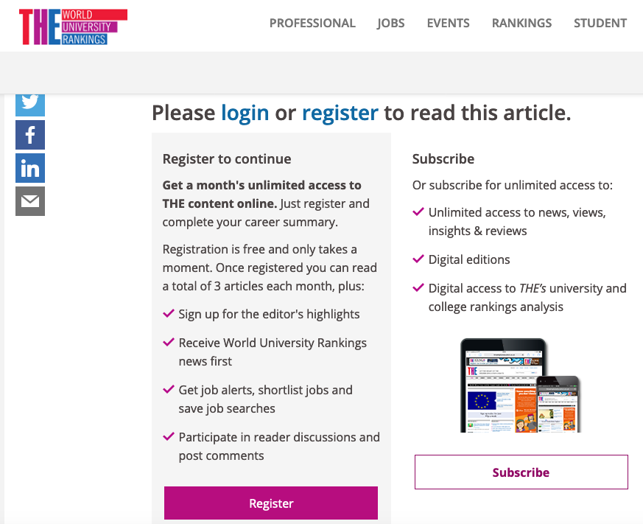
Paywalls, Copyright and OERs
Notes:
The screenshot shows a fairly typical use of a paywall to restrict access to the a particular website in this case the THE content
Paywalls also used by
Newspapers
blogs
and publishers
A Paywall requires you to pay to access a resources. Like when you go to an online newspaper and can see the news headline and then find out you cant read the article unless you have paid for the premium version.
Have you ever tried to access a “free” application for example? I can think of online polling tools like sli.do and poll everywhere as examples. They advertise as free but when you set up an account and try and use the tool you release that the free version has very limited functionality. A bit like accessing the THE articles. You can register for “free” access but free is limited to 3 articles a month.
What does this mean for equity of access. It’s easy of you are a well funded T&L organisations but resource constrained organisations (or individuals) looking for information or resources are disadvantaged.
,

Slide 5
Paywalls, Copyright and OERs
https://www.needpix.com/photo/download/486953/internet-copyright-protection-usage-rights-attorney-insurance-free-pictures-free-photos-free-images
Notes:
Did you know that just because you can access information online it doesn’t mean its free. ALL information on the internet is copyrighted UNLESS it has a Creative commons licence. So if you are cutting and pasting and using information and images from the internet you are really using copyright material
However this is this funny “grey “ area in between what is copyright or free to use and that’s called fair use. Fair use in copyright law provides for the principle, that the reproduction of copyright works for certain limited, educational purposes, does not constitute copyright infringement. Which means that Materials can be used in class if its for the purpose of serving the needs of a specified educational program.

Slide 6
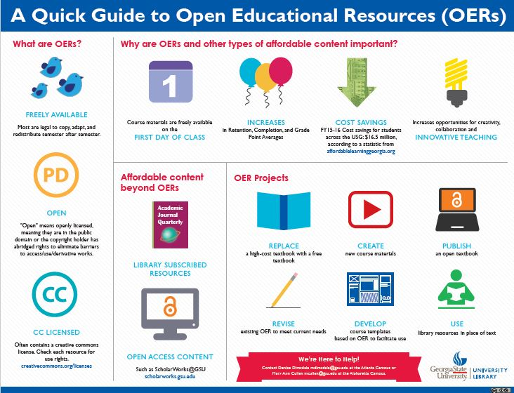
Paywalls, Copyright and OERs
http://research.library.gsu.edu/openeducation
Notes:
OERs are "teaching, learning, and research resources that reside in the public domain or have been released under an intellectual property license that permits their free use and repurposing by others.

Slide 7
https://library.fmcc.edu/oer
Notes:
How do people use OERs – work through slide and talk through the 5 R’s

Slide 8
Benefits and challenges of OERs
Accessibility
Low cost
Easy to use f2f and online
Lots of materials out there
Don’t reinvent the wheel
Specialize
Quality
Sustainability
Tie consuming
Intellectual property issues
_
+
https://pixabay.com/illustrations/justice-scale-scales-of-justice-914228/
Notes:
Many opportunities but some challenges
Talk through both sides of the scale

Slide 9
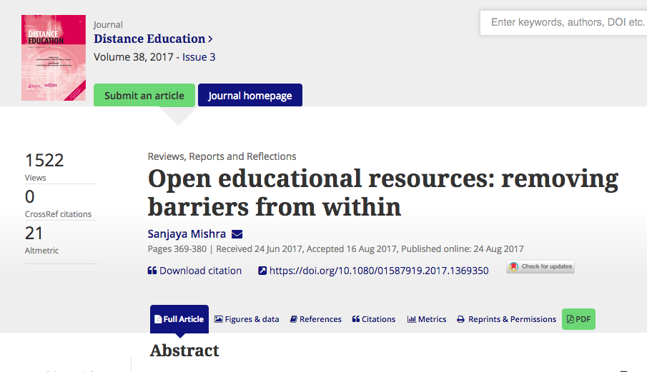
https://www.tandfonline.com/doi/full/10.1080/01587919.2017.1369350
Notes:
If you want to read more and explore how to take this further have a look at this open access academic article by Dr Mishra from
A better understanding of OER by policy-makers, educational administrators, teachers, students and the public at large would foster an enabling environment for OER through national policies, which would strengthen commitment to and funding for sustained campaigns and capacity-building for OER integration in teaching and learning.
current need is for content development as OER, capacity-building in its integration in teaching and learning, collaboration at the national and international levels to advocate for OER, work on OER projects, and the gathering of evidence of the impact of OER on increasing access and improving the efficiency and quality of learning

Slide 10
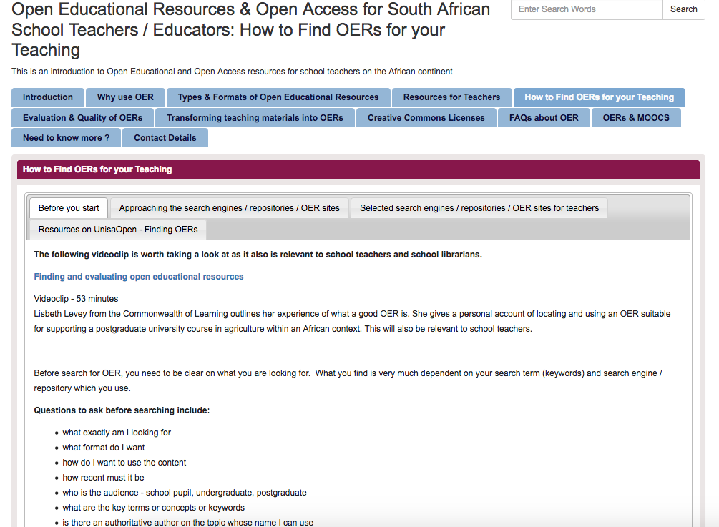
Strategies for using OER as a teacher
http://libguides.unisa.ac.za/c.php?g=507617&p=3473382
Notes:
One of the problems teachers often face is how to find OER’s
You might remember some simple strategies that we covered last week like using the advanced search of Google to narrow your search by usage rights and choose to view only resources that are free to use and share.
However this resource provides other useful strategies and places to search for OER as a teacher – more practice based guide

Slide 11
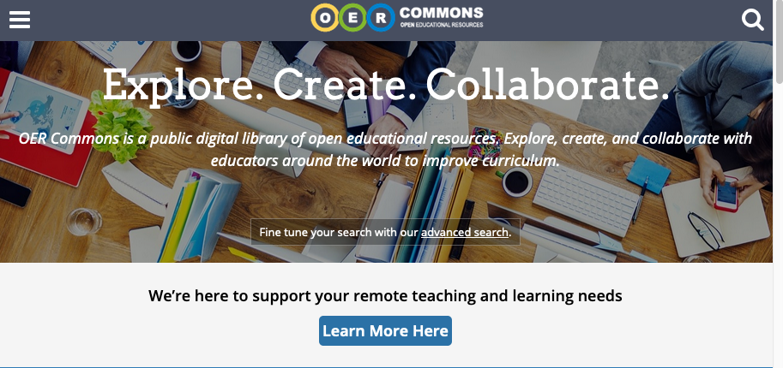

Slide 12
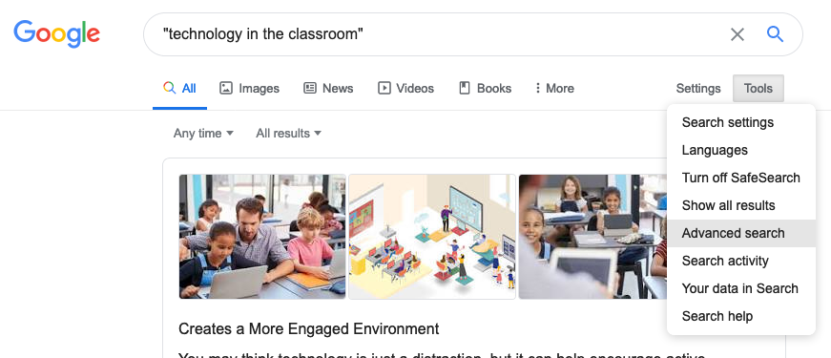

Slide 13
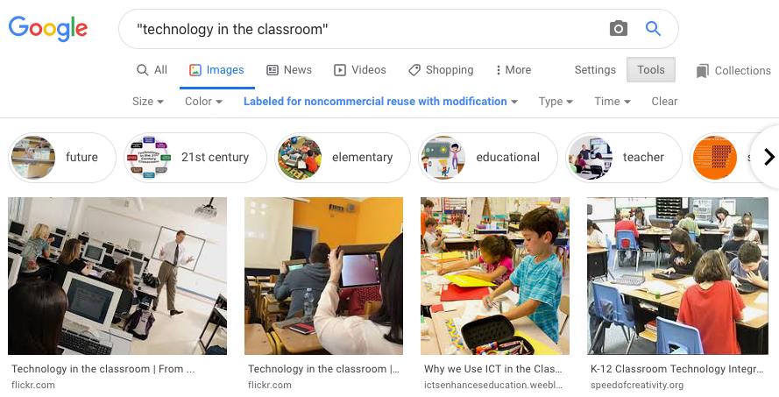

Slide 14
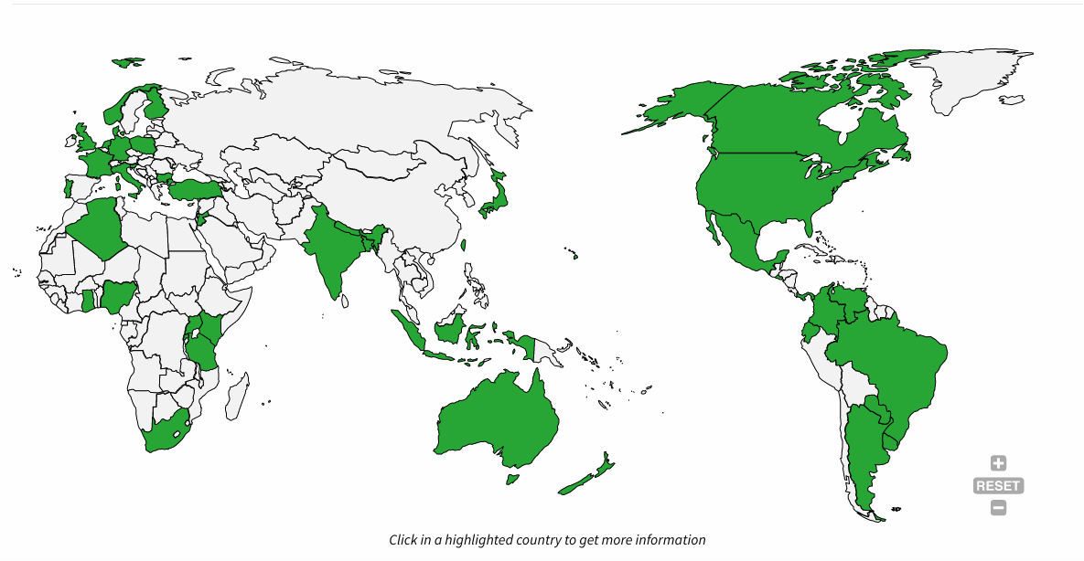
https://network.creativecommons.org/
Notes:
It may be that there is a creative commons chapter in your country . Go to the Creative commons website and you can search for global networks.

Slide 15
Thank You
© Commonwealth of Learning, 2020. Available in Creative Commons Attribution-ShareAlike 4.0 International license to copy, remix and redistribute with attribution to the original source (copyright holder), and the derivative is also shared with similar license.

