Slide 1
Design thinking Approach
fostering innovation in teaching and learning, enabling lecturers in higher education to think differently about teaching and learning
involves a process of reconceptualising the role of the teacher, the role of the learner
the role of the teacher is no longer the developer or deliverer of course content, but the designer of learning experiences.

Slide 2
Design Thinking -- Maximizing Your Students' Creative Talent
https://www.youtube.com/watch?v=nyt4YvXRRGA

Slide 3
https://tll.gse.harvard.edu/design-thinking

Slide 4
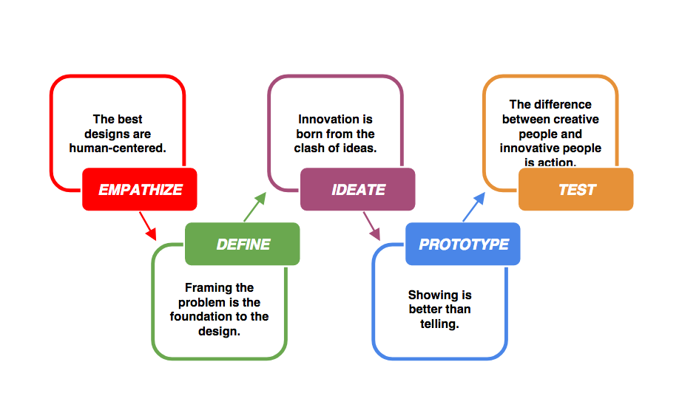

Slide 5
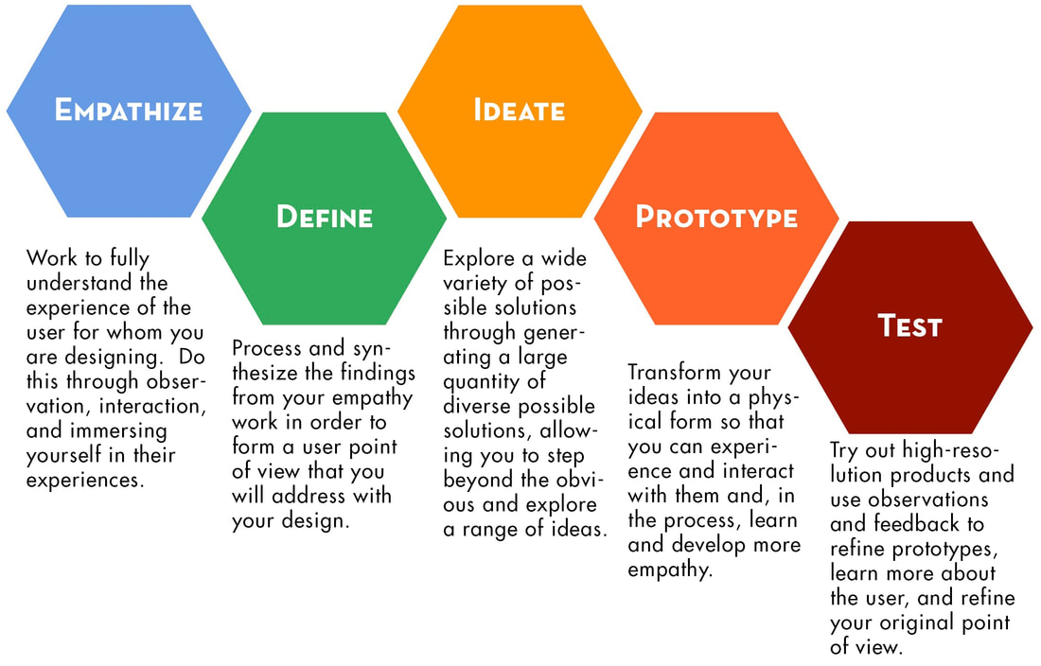

Slide 6
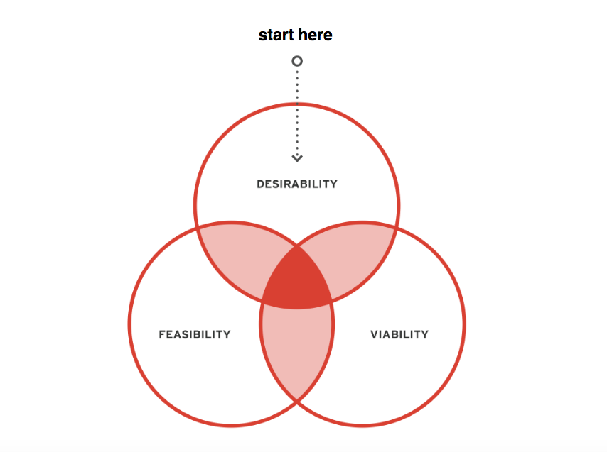

Slide 7
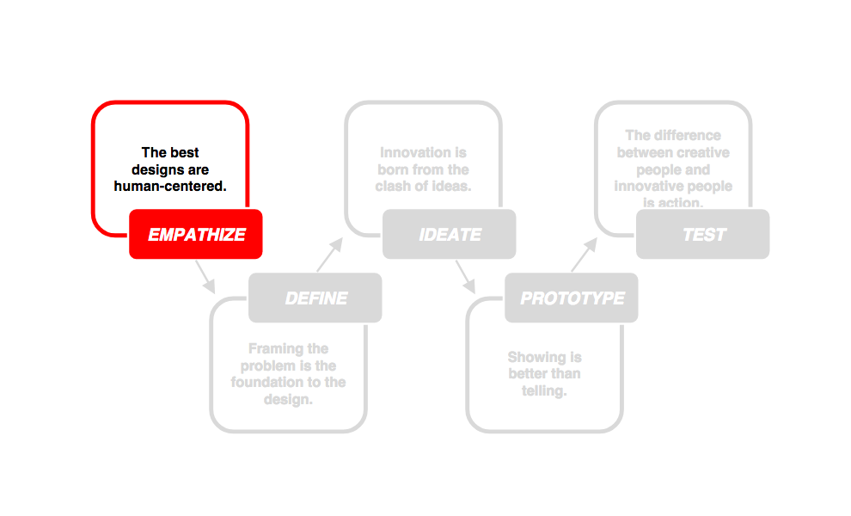

Slide 8
Your learner experiences
What was the absolute best experience you had in a class?"
Or
What was the worst experience you ever had?
Say
Think
Do
Feel

Slide 9
Learning / Teaching challenge/ high/ lowlight

Slide 10
Learning / Teaching challenge/ high/lowlight

Slide 11
Want to explore more?
https://www.oercommons.org/search?batch_start=20&f.search=%22design+thinking%22
https://designthinkingforeducators.com/

Slide 12
L&T challenge
Think about a teaching and learning challenge you are currently facing and want to solve
Seek some input on how someone else views that challenge

